Slide 1
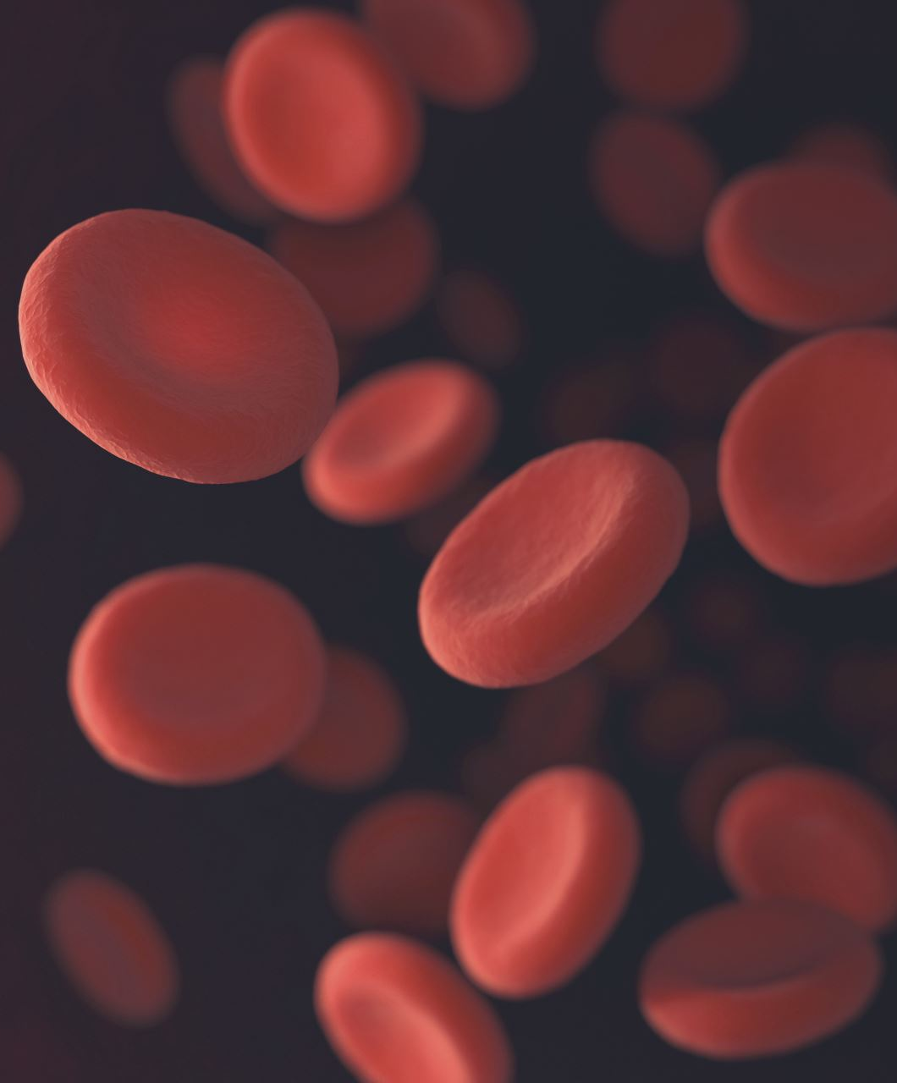
Diagnosis of coronary artery disease
UCI – heart disease dataset
Kacper Kozik
Mikolaj Pniak

Slide 2
1. Introduction
The goal of this project was to predict heart disease.
We used the UCI Heart Disease dataset to compare various machine learning models in a binary classification task - detecting whether a patient has heart disease or not.
The focus was on thorough data preprocessing, model performance comparison, and understanding how different techniques affect results.

Slide 3
2. UCI – HEART DISEASE DATASET
Age:
Patient’s age (range: 28–77)
Sex:
0 = female,
1 = male
Cp: Chest pain type
(0-typical, 1-atypical, 2-non-anginal, 3-asymptomatic)
Trestbps:
Resting blood pressure (mm Hg)
Chol:
Serum cholesterol (mg/dl)
Fbs:
fasting blood sugar > 120mg/dl = 1 (yes)
Restecg:
Resting ECG results (0-normal, 1-ST-T abnormalities, 3-LV hypertrophy)
Thalach:
Max heart rate achieved during excercise (bpm)
Exang:
Exercise-induced angina (1 = yes)
Oldpeak:
ST depression during exercise (compared to rest)
Slope:
Slope of ST segment (2-upsloping, 1-flat, 0-downsloping)
Ca:
Number of major vessels with narrowing (0–3)
Thal:
Thallium Stress Test Result(0–3)
UCI Heart Disease dataset from the UCI Machine Learning Repository
Combines data from Cleveland, Hungary, Switzerland, and VA Long Beach
Focus on 13 key features related to heart disease to predict target feature
Target:
Originally ranged from 0 (no disease) to 4 (severe). Transformed into binary:
0 (no disease)
1 (Heart disease present)

Slide 4
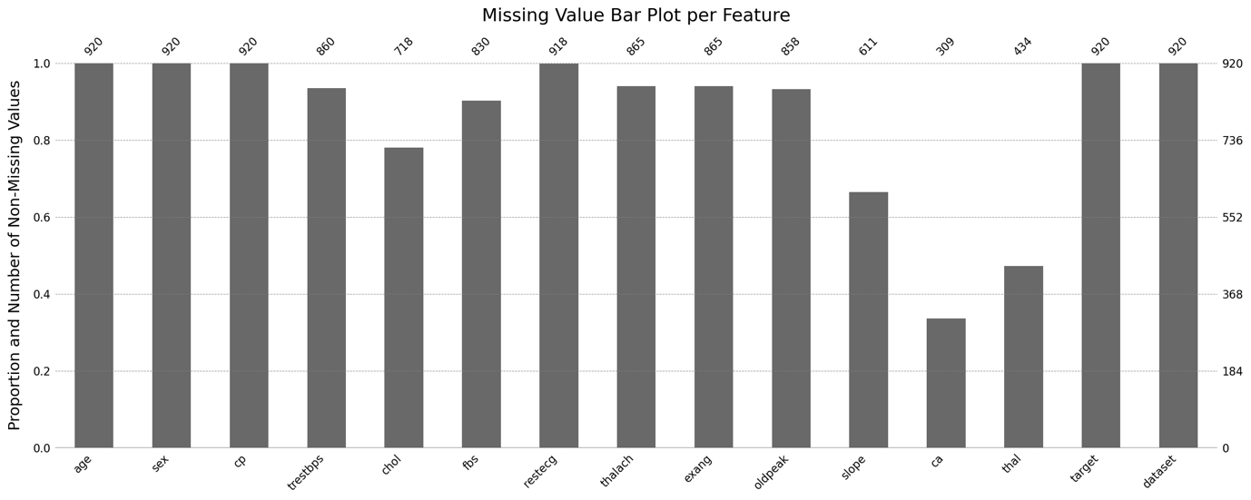
UCI – HEART DISEASE DATASET
ca, thal - high number of missing values
slope, chol - moderate missingness

Slide 5
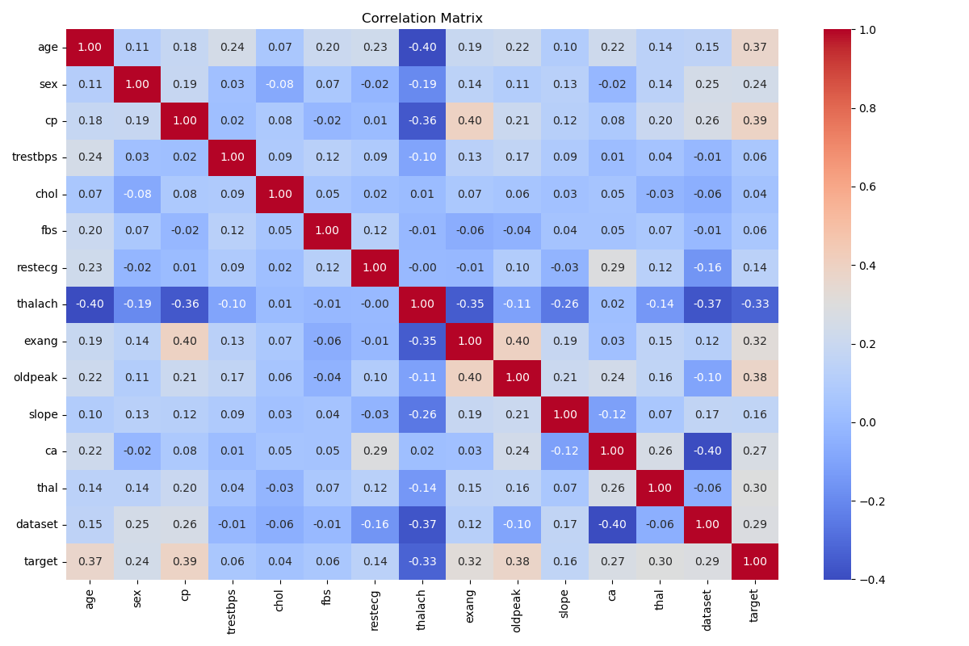
correlations
Strong feature correlations:
age vs thalach (max. heart rate during ex.)
oldpeak (ST depression during ex.) vs. exang (Ex. induced angina)
thalach vs. cp. (chest pain type)
thalach vs. exang

Slide 6
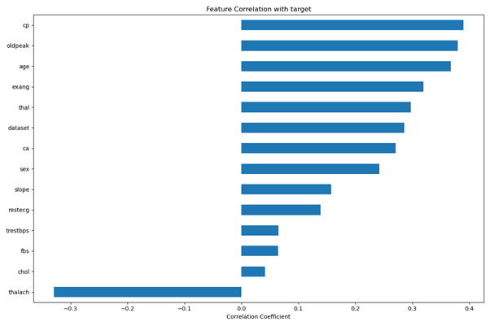
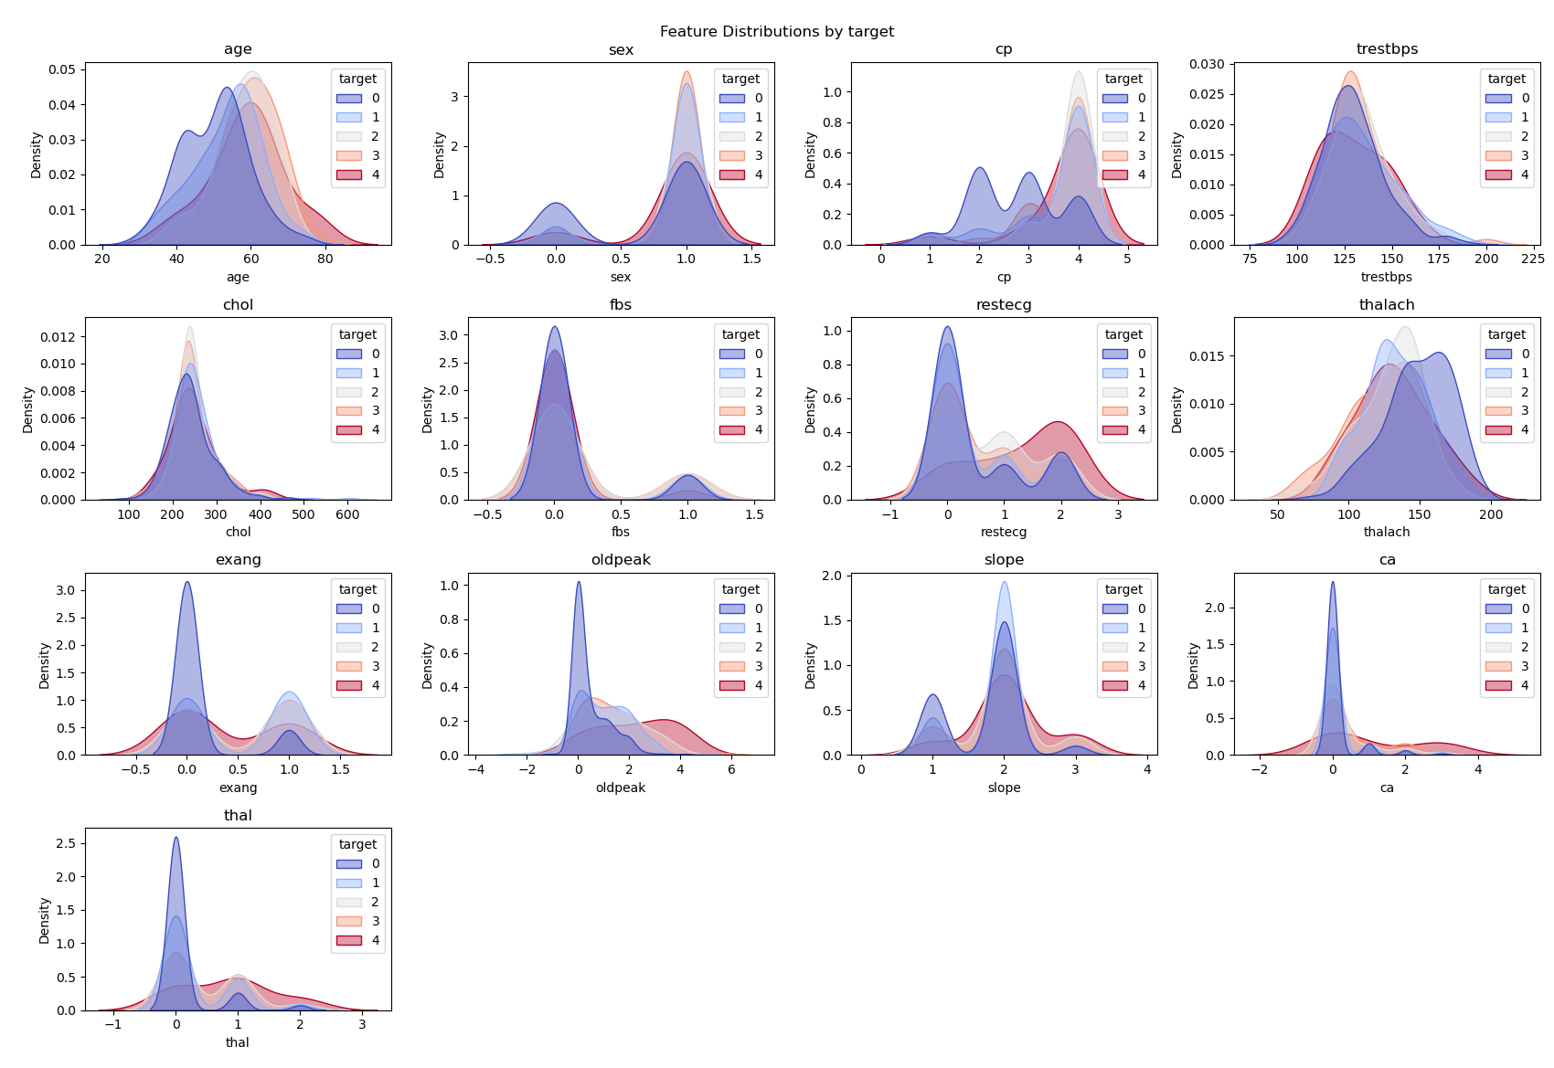
Correlations with target

Slide 7
3. Preprocessing - Feature Engineering
Goal: Create new features from existing data to highlight important patterns:
Medical based scores
Framingham Score
Age Squared
Grouped Medical Features:
Pain Related
Food Related
Exercise Related
ECG Related
Dead Cells Related
Framingham Score: Combines age, sex, cholesterol, blood pressure, and blood sugar
Captures non-linear effects of age on heart risk

Slide 8
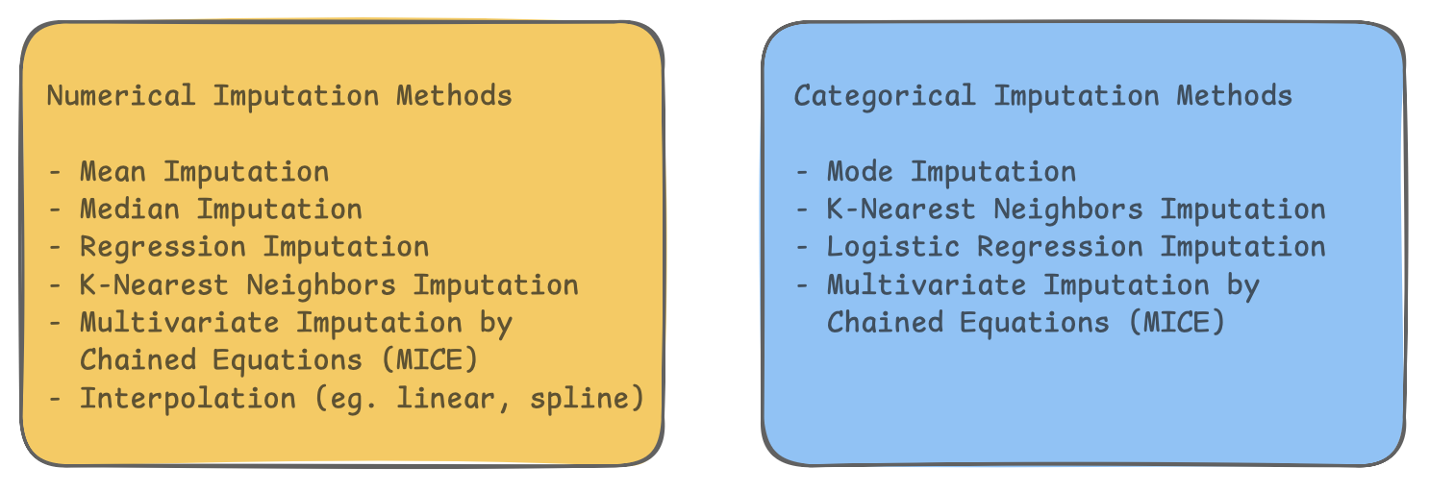
Imputation strategies
For numerical features we used:
Mean/median
Knn imputation
Mice
For categorical features we used:
Mode imputation
Early mistake: fitting on full dataset, which lead to artificially high scores

Slide 9
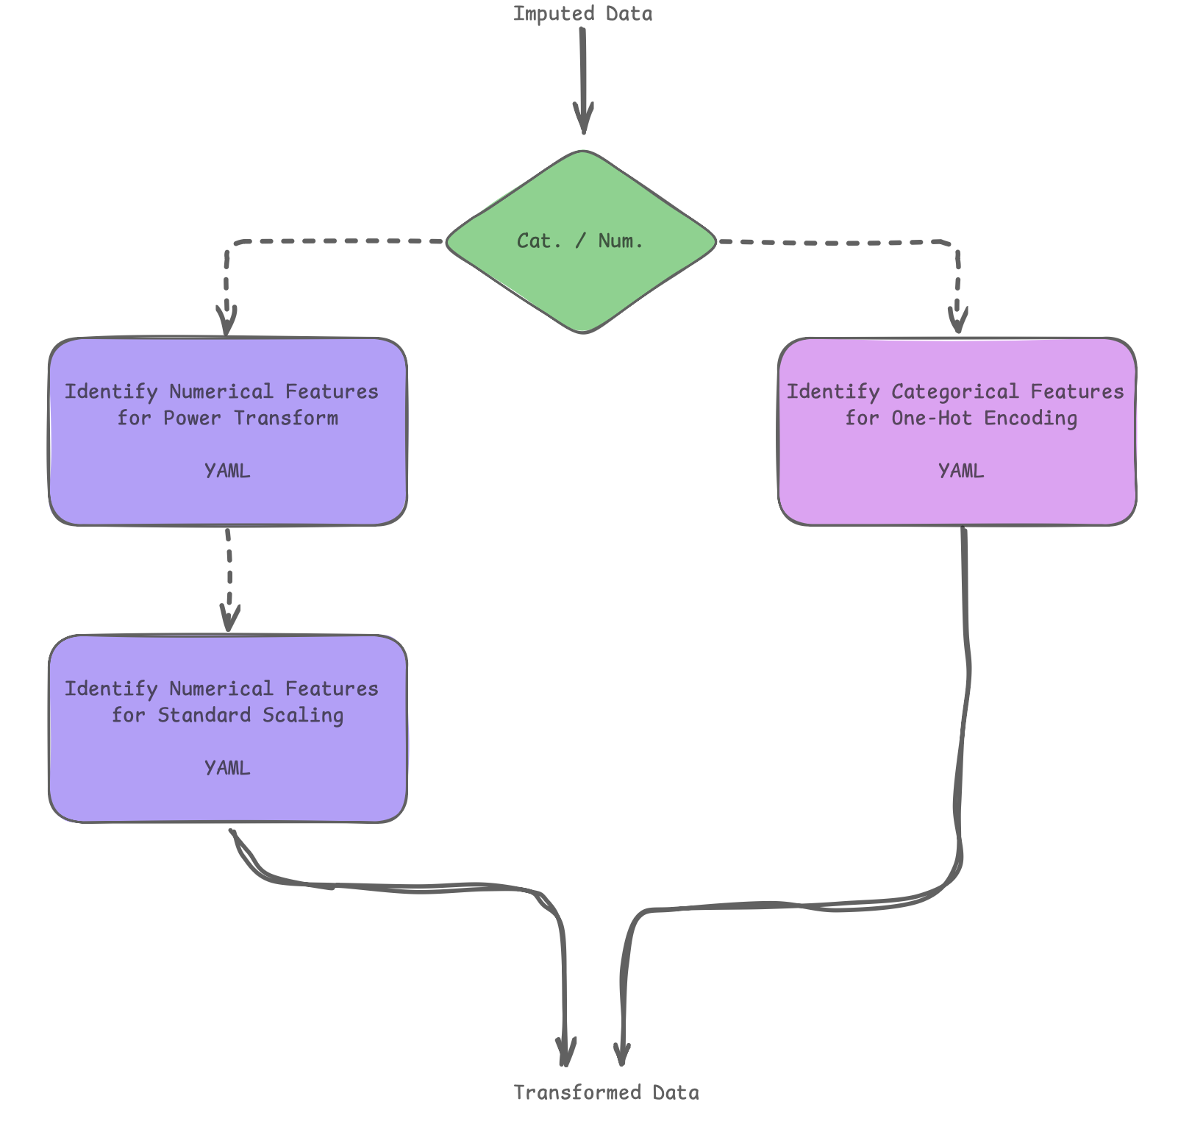
Scaling and encoding
Data Transformation:
Critical for scale-sensitive alghoritms (e.g. SVM)
Categorical features:
One-Hot Encoding for cp, thal, sex, dataset
Numerical features:
Power Transformation (Yeo-Johnson) applied to oldpeak, trestbps, and feature engineered features.
Standarization : all features

Slide 10
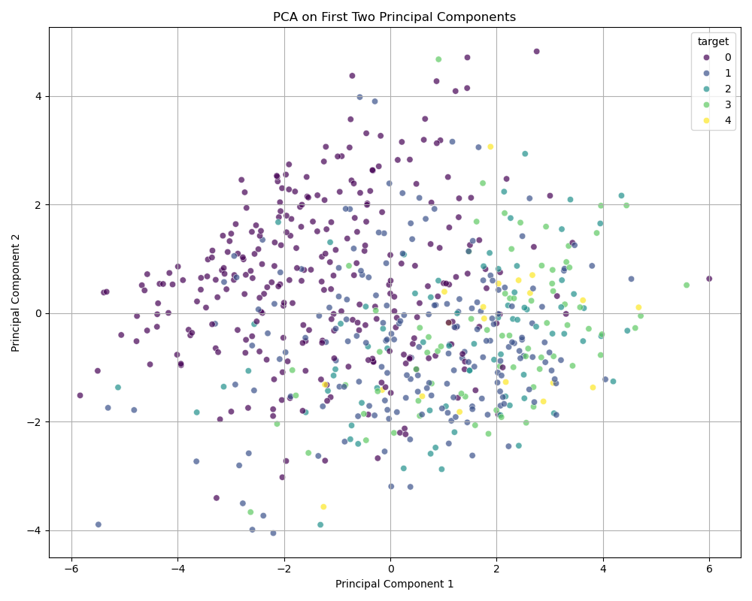
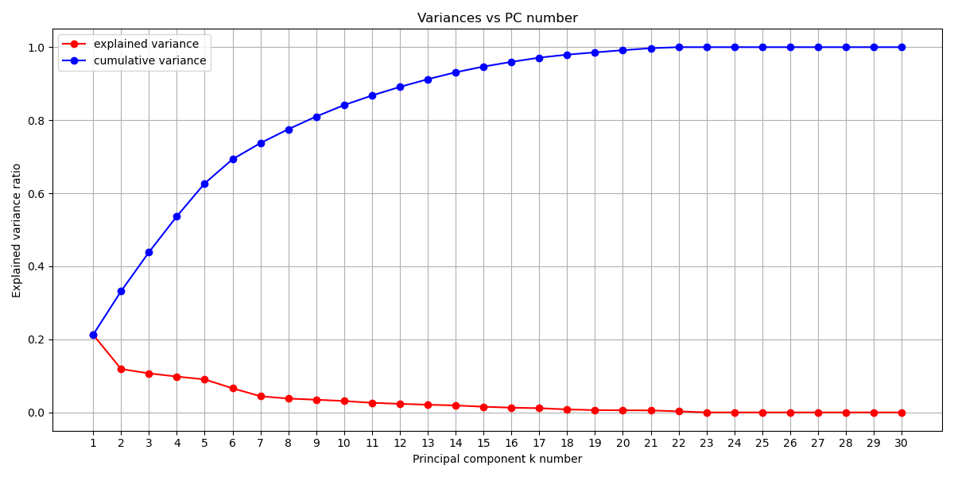
Dimensionality reduction - PCA
Our PCA Strategy:
Retained enough components to explain 90% of total variance

Slide 11
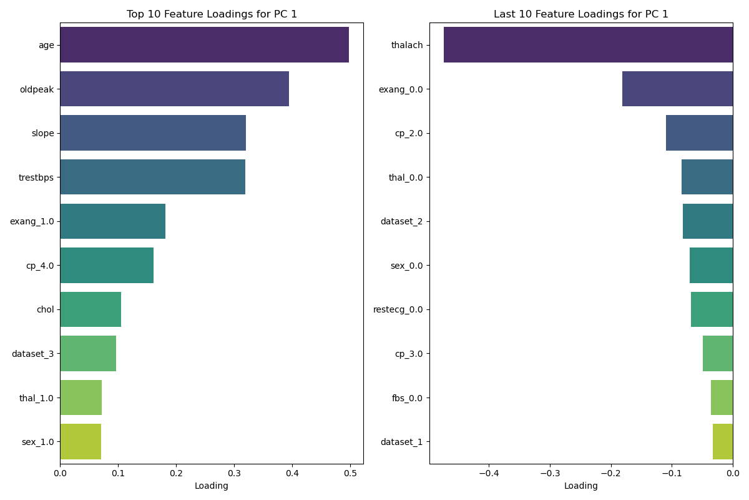
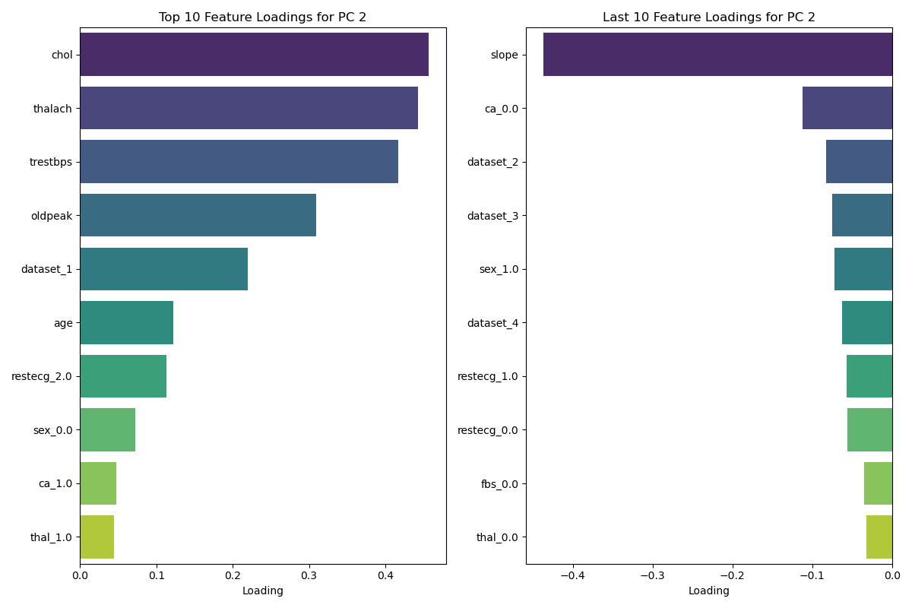
Dimensionality reduction - PCA

Slide 12
4. BUILDING AND TUNING PREDICTIVE MODELS
Baseline Models Performance:
Before optimization we trained each model using a set of defined, static hyperparameters
Hyperparameter Optimization with Optuna, optimize F1-score:
SVM:
C, kernel, gamma, degree
Random forest:
n_estimators, max_depth, min_samples_split, min_samples_leaf, max features
LightGBM:
n_estimators, learning_rate, num_leaves, max_depth, reg_alpha, reg lambda, colsample_bytree, subsample, min child samples
Models:
SVM: Support Vector Machines
Random Forest
LightGBM: Light Gradient Boosting Machine
Metrics:
Accuracy
Precision
Recall
F1-score
AUC-ROC

Slide 13
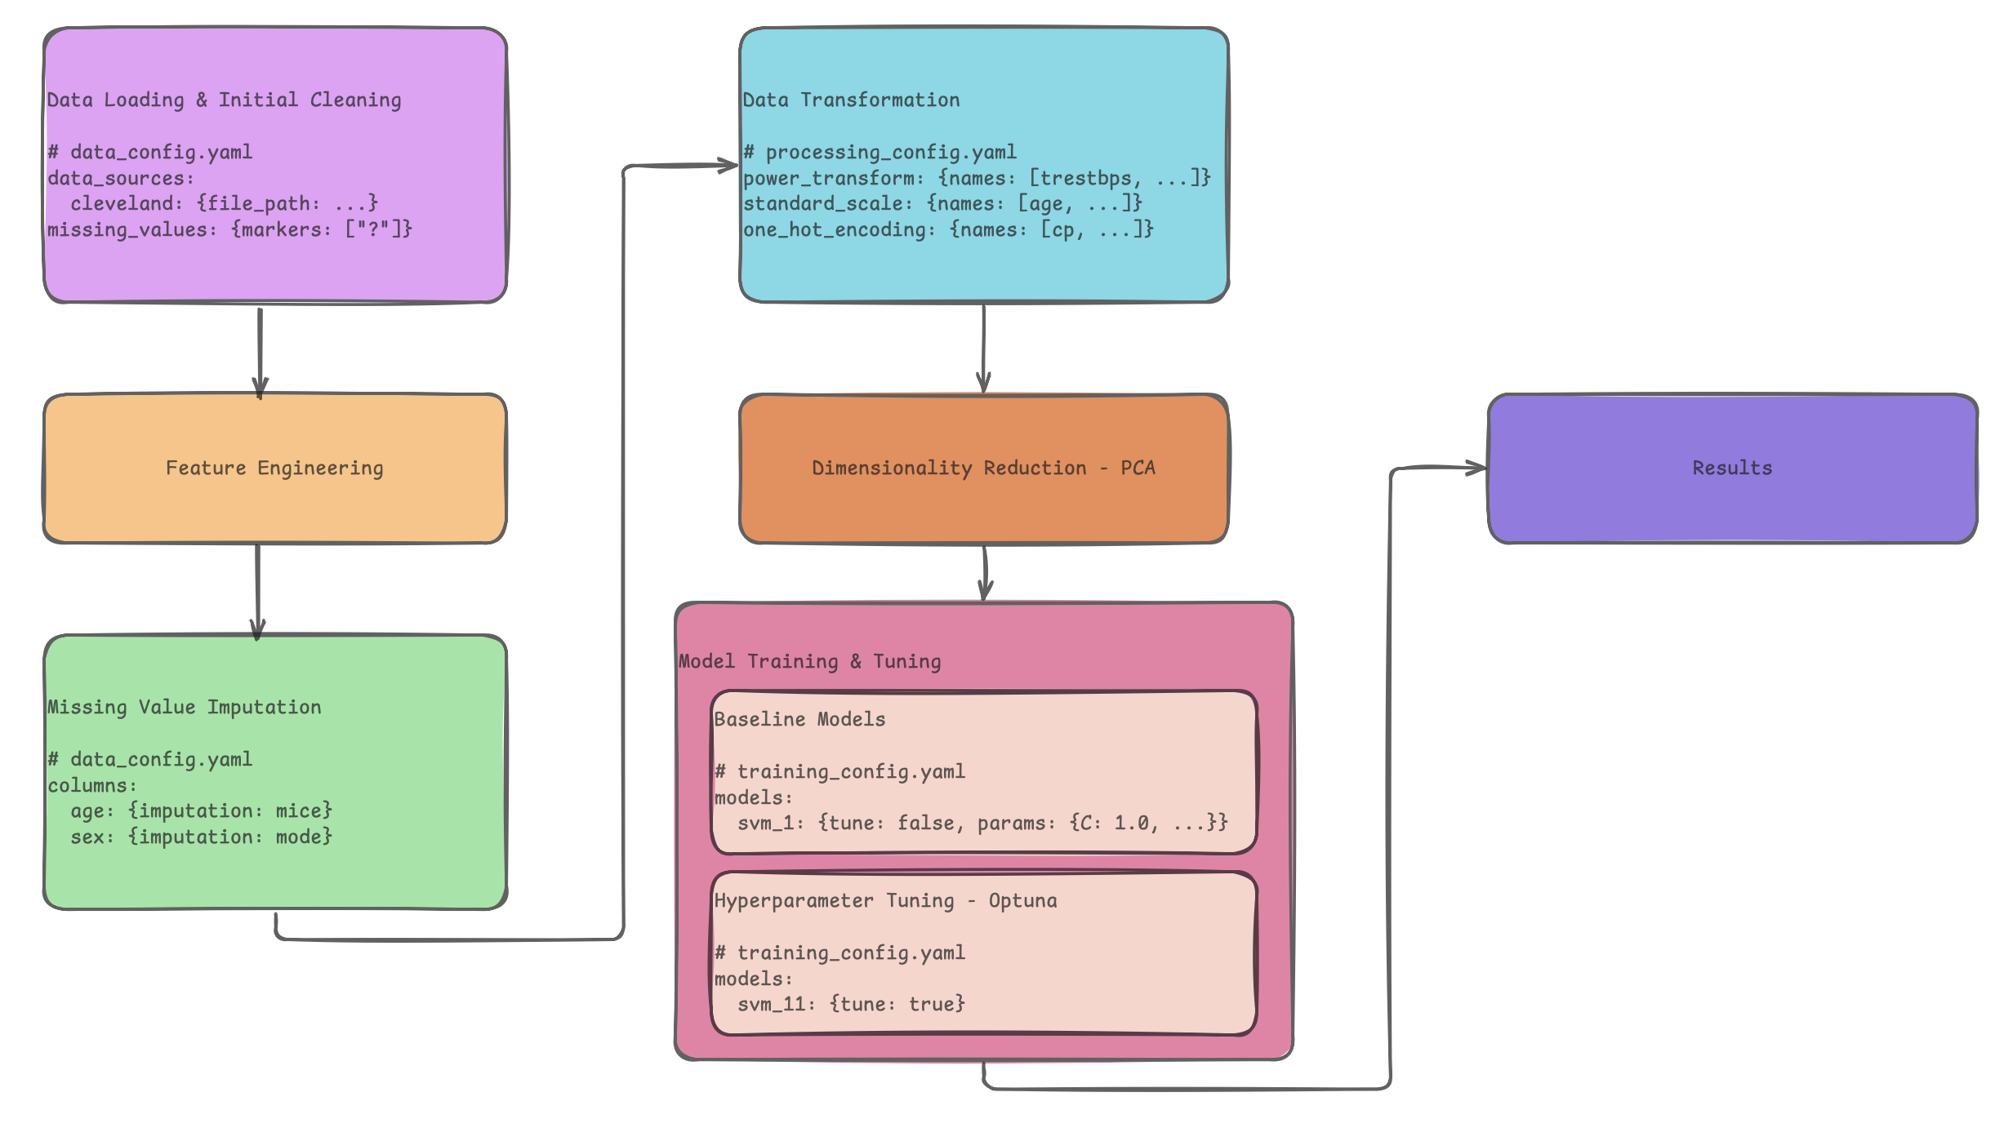
5. PIPELINE OVERVIEW

Slide 14
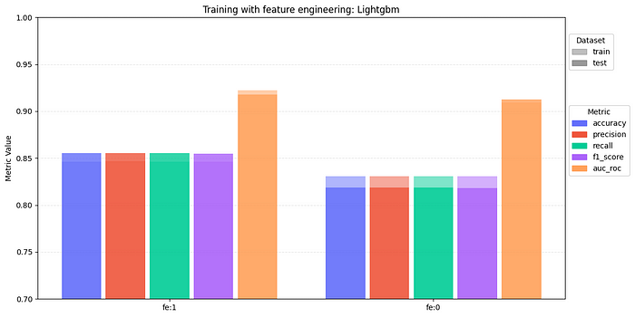
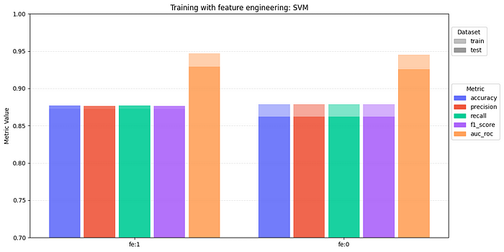
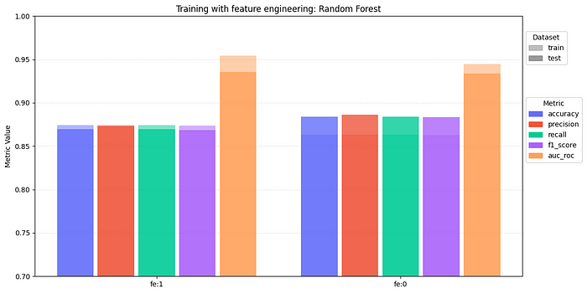
6. EVALUATING MODEL PERFORMANCE feature engineering impact

Slide 15
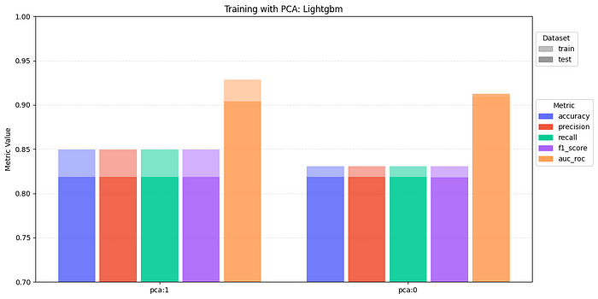
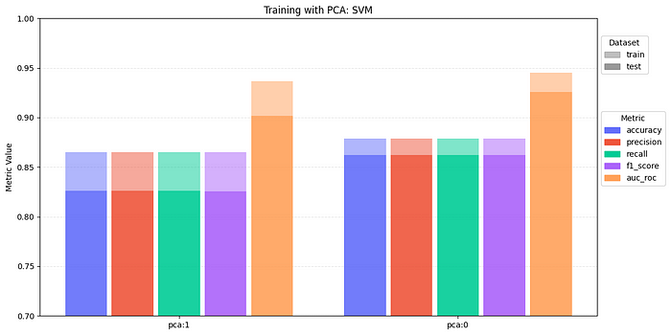
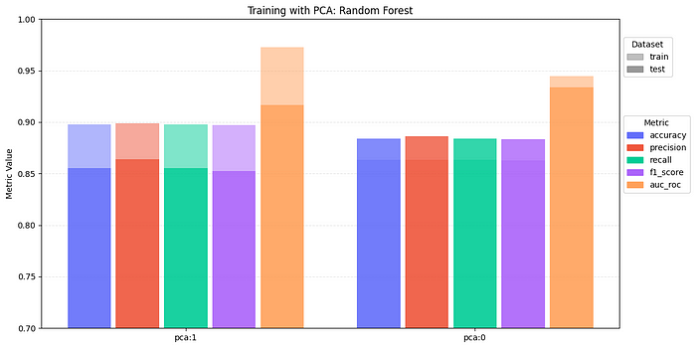
6. EVALUATING MODEL PERFORMANCE IMPACT OF DIMENSIONALITY REDUCTION

Slide 16
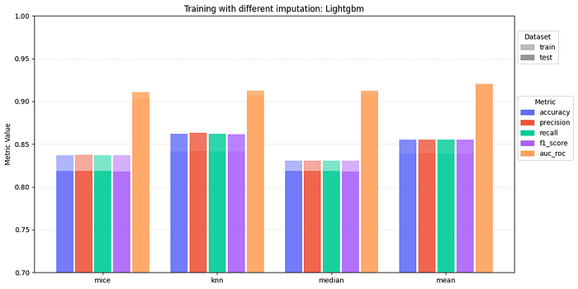
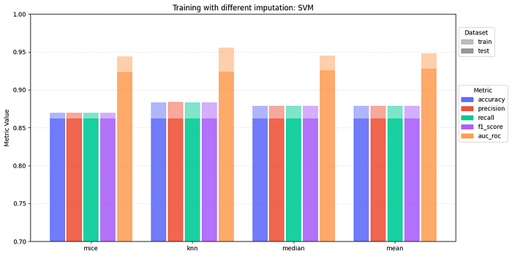
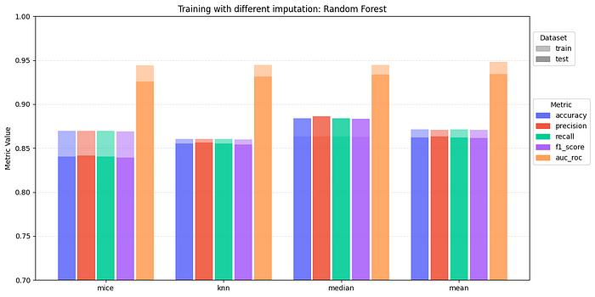
6. EVALUATING MODEL PERFORMANCE impact of imputation methods

Slide 17
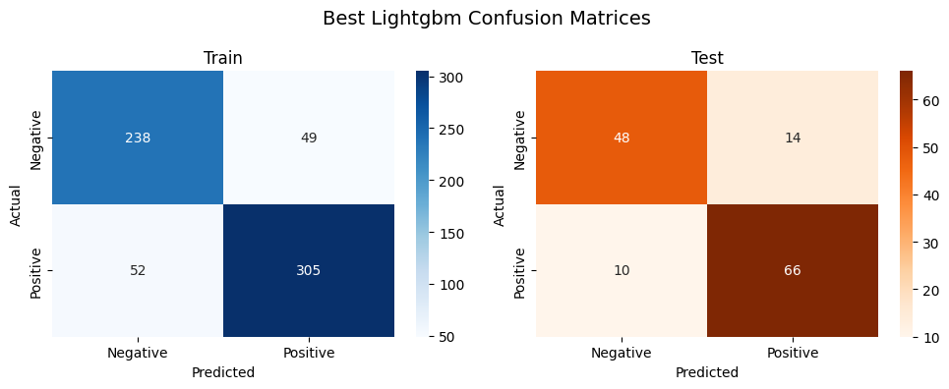
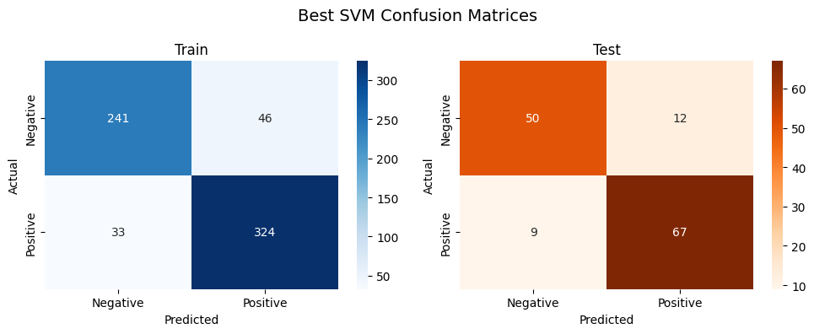
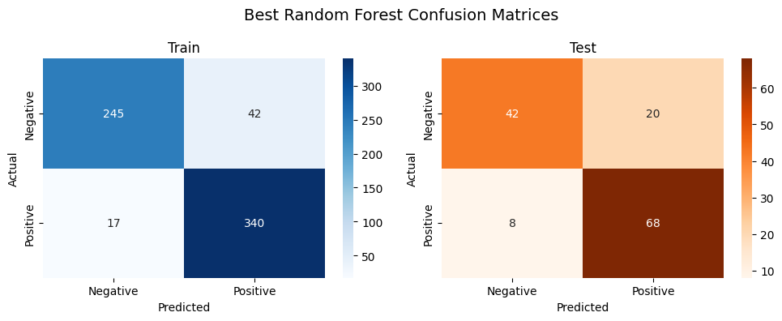
6. EVALUATING MODEL PERFORMANCE PERFORMANCE OF best CLASSIFICATION MODELS

Slide 18
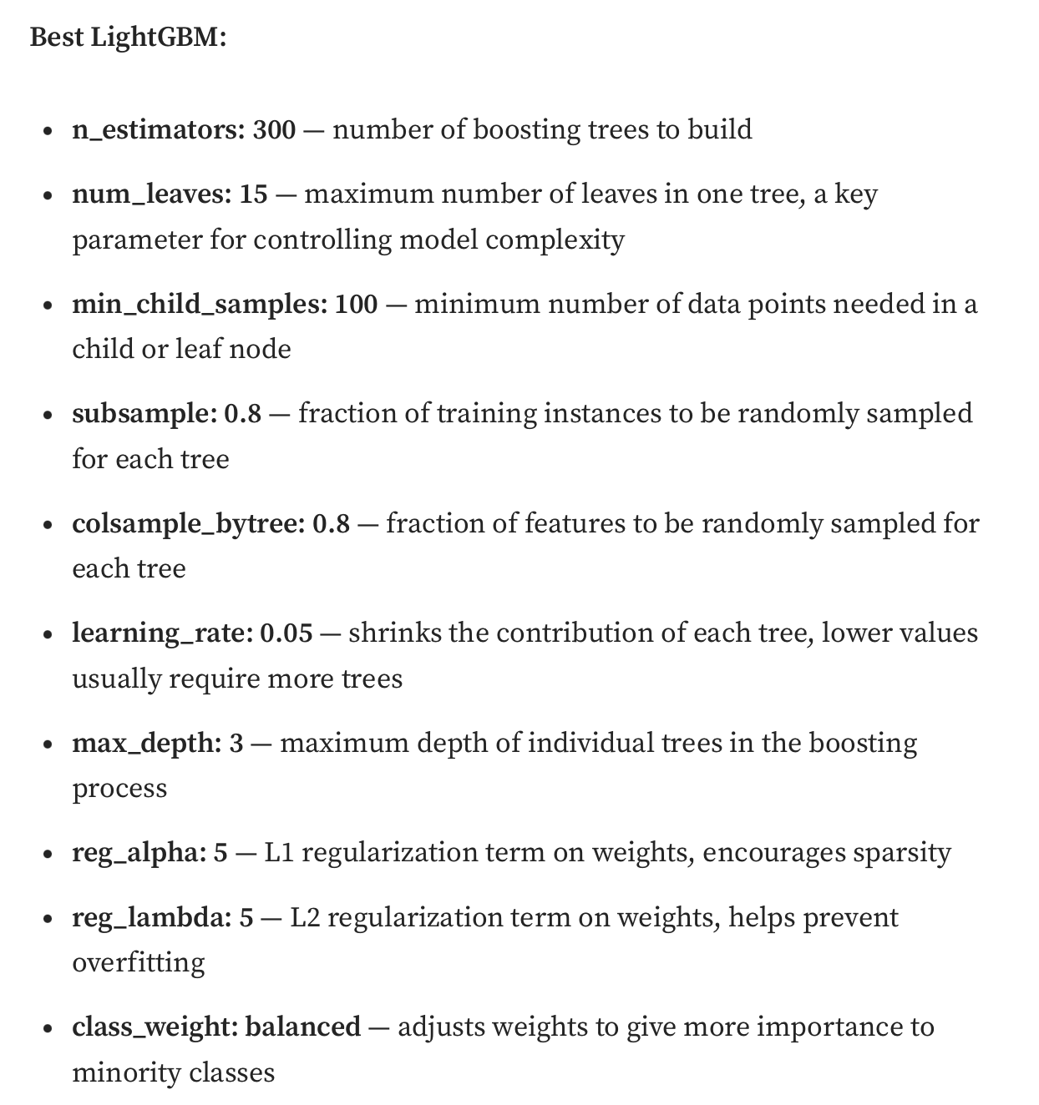
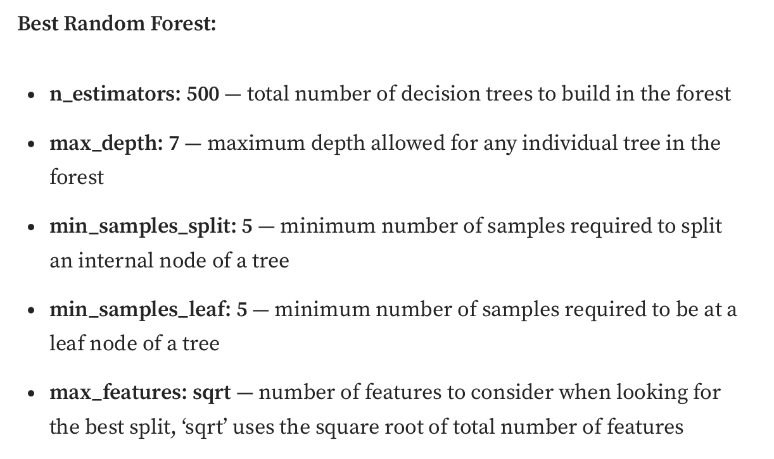
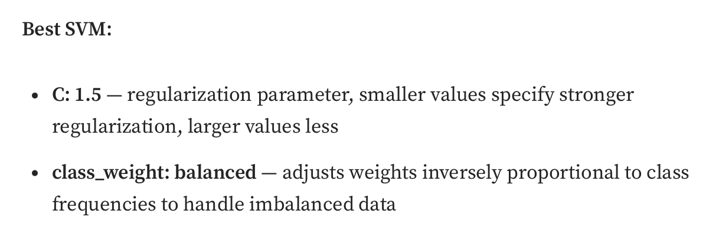
6. EVALUATING MODEL PERFORMANCE PARAMETERS OF best CLASSIFICATION MODELS

Slide 19
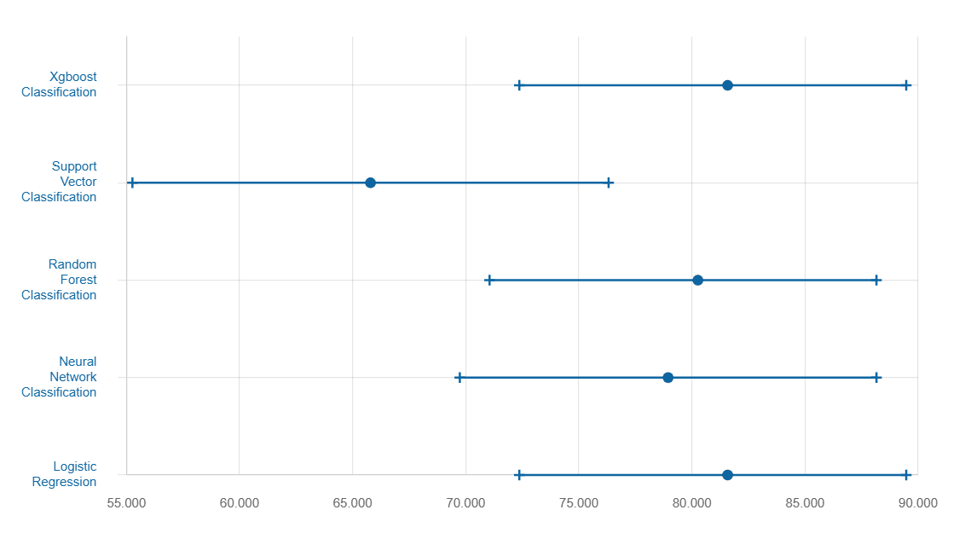
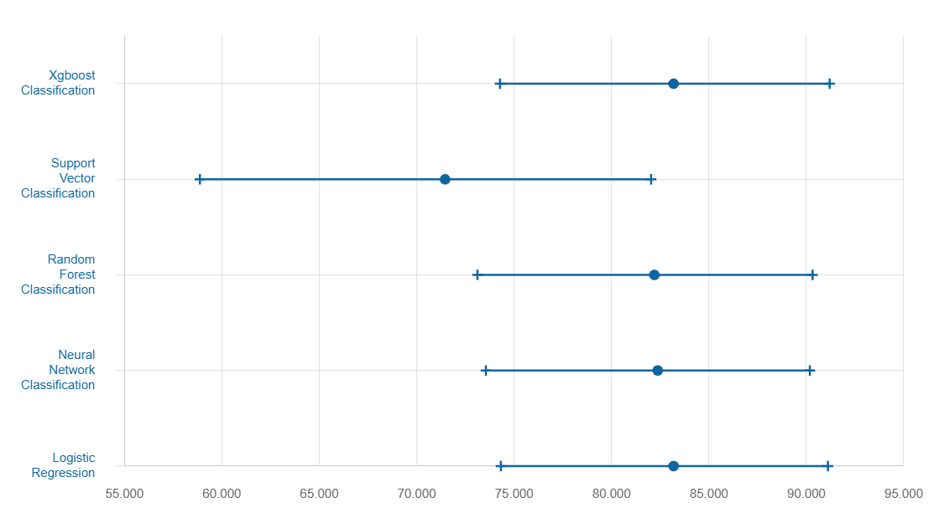
6. EVALUATING MODEL PERFORMANCE
Accuracy
Precision
Our best SVM:
Accuracy: 87.7%,
Precision: 87.5%
https://archive.ics.uci.edu/dataset/45/heart+disease

